Slide 1
Big Mountain Resort
Ticket Price
Guided Capstone Project Report
Albert Cochrane

Slide 2
Problem Overview
How should Big Mountain Resort set its ticket prices in order to maximize revenue in the coming season?
Moreover, how would the facility changes management is currently considering impact pricing and revenue?
In this presentation, we will present the findings obtained by statistically analyzing data from hundreds of resorts around the United States and creating a model to provide a educated price based on what features are offered at a given resort.

Slide 3
Recommendation : $95.87
Currently, Big Mountain is charging $81.00 per ticket.
Based on the facilities that the resort provides, our model suggested that a price of $95.87 would be more suitable in the current marketplace.
Given that the number of visitors per season is currently 350,000, with an average stay of 5 days, this change in ticket price would generate $15,613,500 in additional revenue per season.

Slide 4
Modeling Results
We performed a statistical analysis to identify the most important features contributing to the price of a ticket.
Our final modeling algorithm could predict a resort’s price with a mean absolute error of only $10.39.
On the next slide, we will look at a plot generated from our modelling which display the features we found to be most relevant to selecting a price.

Slide 5
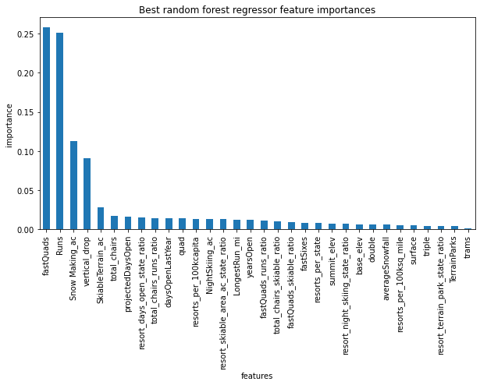
Plot of most important features

Slide 6
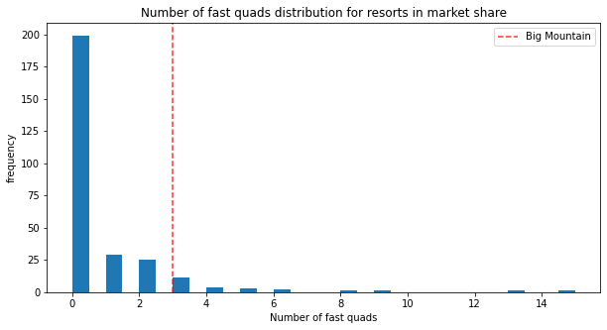
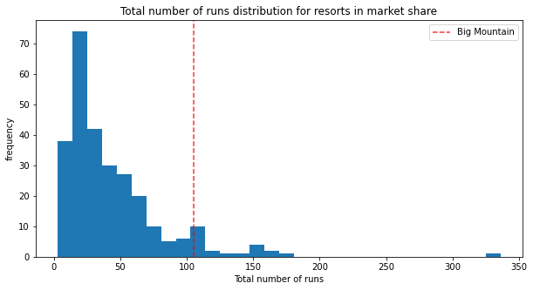
Justification for the price increase
Big Mountain resort rates among the best in the country in nearly all of the key features a resort can offer. Below, you can see where it lies on the distribution of resorts across the country with respect to number of fast quads and total runs, which were the two most important features.

Slide 7
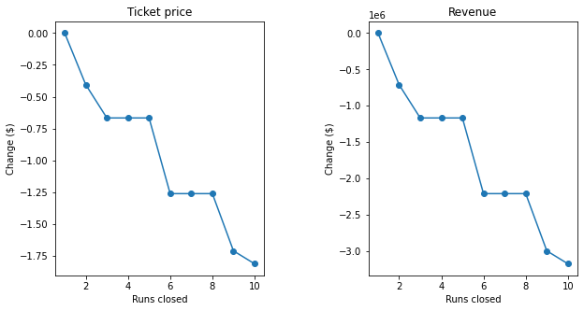
Recommended Changes
Our analysis evaluated that the best was #2, where a run would be added along with an additional chair lift. With these changes, we could expect an additional $1.99 increase to the ticket price, which amounts to $3,474,638 in additional revenue over a season. The other scenarios considered either did not increase the price or caused a decrease, which can be seen in the plots below displaying the impact of closing runs.

Slide 8
Summary
We used data from 276 resorts around the country to create an educated pricing model from which we made our recommendations.
In conclusion, we would recommend setting the ticket price to $95.87.
Of the 4 facility changes being considered, we would recommend scenario #2.

